Slide 1

ANALYSIS AND PREDICTION OF CRIME IN INDORE CITY
Project Supervisor: Dr .Prayla Shyry , M.E., Ph.D.,
Name of the Student: Miss . Supriya Repalle
Register Number: 39110846

Slide 2
Presentation Outline
Course Certificate
Introduction
Objectives
System Architecture
Project Implementation
Methodology
Results
Conclusion & Future work
References

Slide 3
Course Certificate

Slide 4
Introduction
Madhya Pradesh's commercial capital Indore has topped the crime record in the country in 2008 followed by Bhopal and Jaipur. Crime rate of Indore was 941.4, which is the highest in the country, according to National Crime Record Bureau's (NCRB) report - "Crime in India 2008".
With the rapid urbanization and development of big cities and towns, the graph of crimes is also on the increase. This phenomenal rise in offences and crime in cities is a matter of great concern and alarm to all of us. They feel very insecure and vulnerable in the presence of anti-social and evil elements. The criminals have been operating in an organized way and sometimes even have national wide and international connection
The problem statement is to find out the type of crime using the date and time of the crime at a particular place using the latitude and longitude given.
The attributes of the dataset are timestamp and the various acts which areAct 379 - Robbery ,Act 13 - Gambling ,Act 279 - Accident ,Act 323 - Violence ,Act 302 – Murder, Act 363 – Kidnapping , latitude and longitude.
The inputs of the algorithm is the time,date and place the output is the type of crime

Slide 5
Objectives
The project objective is
Predicting crime before it takes place
Predicting hotspots of crime.
Understanding crime pattern.
Classify crime based on location.
Analysis of crime in Indore
The scope of the project is predicting surges and hotspots of crime, and Understanding patterns of criminal behavior that could help in solving criminal investigations.
The objective of the project can be achieved by the classification algorithm which helps me to classify the type of crime based on the place ,time and date

Slide 6
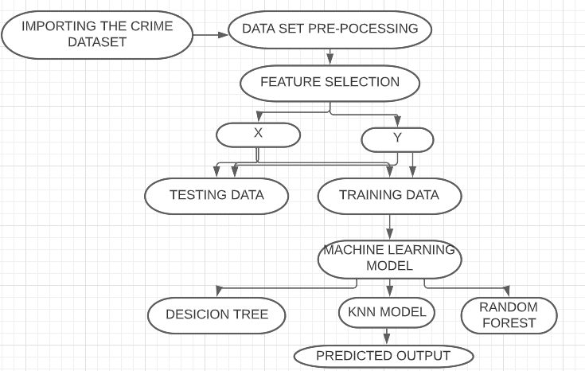
System Architecture

Slide 7
Project Implementation
Modules used:
Pandas
Numpy
Mathplot
seaborn
Scikit-learn
Hardware and Software Requirements
Processor : Processor Intel CORE i3 and above
Internet Connection : Existing telephone lines, Data card,
RAM : 4 GB.
Operating System : Windows, Mac, Linux
Language : Python Programming
IDE : Jupyter Notebook

Slide 8
Methodology
To begin with we have to install Anaconda navigator and open jupyter notebook to execute the commands further.
Import the necessary modules from python library like pandas ,to create a dataframe of the dataset and numpy to store the output values in array form .
For visualizing the data import mathplotlib.pyplot and sns plot to represent the data in figures for the better analysis of each coumn
Then,we preprocess the data that means we split the timestamp column in to day, week ,hour and add that to the dataset for the better accurate results.
Construct the heatmap and snsplot and print the importance of features to take which attributes into the model.
Adding to that ,next we import from sklearn.model_selection import train_test_split and we split the attributes as X and Y X contains the day,hour ,week,latitude and longitude and y contains the 6 types of acts

Slide 9
Methodology
6.Then, fit the model into the KNN algorithm by importing from sklearn.neighbors import KNeighborsClassifier and print score of the KNN for the test and train data and mean squared error ,rmse .
7.Then fit the model into the desicion tree algorithm also by importing from sklearn.tree import DecisionTreeClassifier and print the score of the model
8.Fit the model into the random forest algorithm aloso and find out the score
9.Finally build the predictive model using the predict() with the new input values

Slide 10
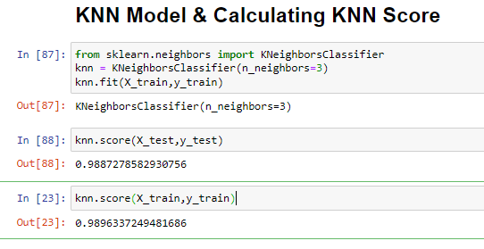
Results and Discussion

Slide 11
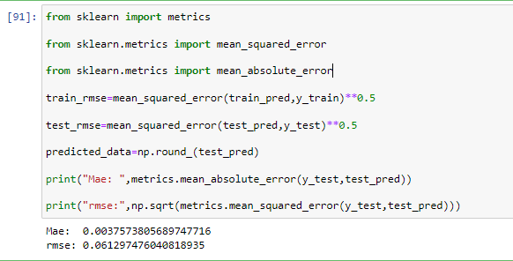

Slide 12
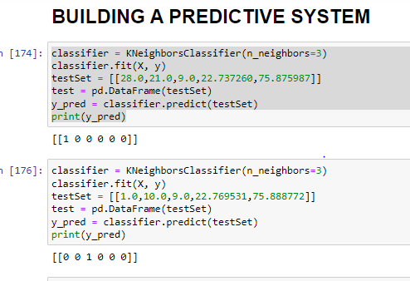

Slide 13
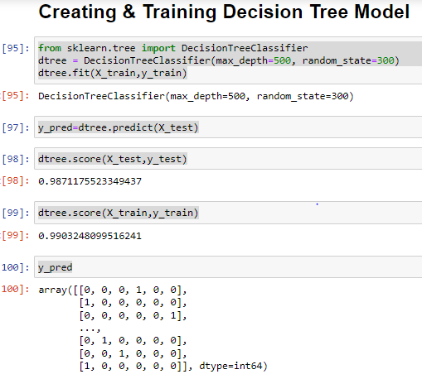

Slide 14
Conclusion
The project is successful in predicting the type of crime with given latitude ,longitude ,day ,week and hour.
The dataset was successfully modeled by the the three machine learning classification algorithms. The results of the visualization shows the heatmap by which we can understand which type of crime was happening the most at what day .The ml model from knn is successful in predicting the type of crime when we give a new input to the model as we observed in the prediction result.
The future scope of the project is to build a website so that it can digitally show the results to the department and on Predicting Who Will Commit a Crime and how often he is doing that we can focus on the Pretrial Release and Parole

Slide 15
References
[1] Kim, Suhong, Param Joshi, Parminder Singh Kalsi, and Pooya Taheri. "Crime Analysis Through Machine Learning." In 2018 IEEE 9th Annual Information Technology, Electronics and Mobile Communication Conference (IEMCON), pp. 415-420. IEEE, 2018.
[2] Bogomolov, Andrey and Lepri, Bruno and Staiano, Jacopo and Oliver, Nuria and Pianesi, Fabio and Pentland, Alex.2014. Once upon a crime: Towards crime prediction from demographics and mobile data, Proceedings of the 16th International Conference on Multimodal Interaction.
[3] Shah, Riya Rahul. "Crime Prediction Using Machine Learning." (2003).
[4]Leo Breiman, Random Forests, Machine Learning, 2001,Volume 45, Number 1, Page5

